Slide 1
Little Falls Strategic Framework 2020-2030 Vision for the Decade
Led by the guiding principles and vision we hold in common
Notes:
TIME: 30 seconds maximum
SPEAKER:
Thank you for the time and this opportunity to share the product of many months and an extensive community listening process.
Launched in August 2019, this process was a unique opportunity for the community to
Consider it’s vision for the community’s future must guide our decision making
And consider our most important assets on which to build
Consider the obstacles that block progress
Today we bring to you the results of this process, with the opportunity for your consideration and a request that the resulting framework be adopted by the city go inform and shape our future.
It is important to note that as we were completing our listening process, the pandemic swept in and closed down our community. We have accepted a new reality of what normal is going to look like, what our opportunities are going to be in the near future. While timelines may shift, this framework offers just that, a flexible frame in which to prioritize decisions and continue to focus on a future while facing the challenges of the present moment.

Slide 2
What is a Strategic Framework?
A brief document that sets a broad vision and outlines a strategic direction along which the future might unfold.
A tool designed to connect big picture strategic elements (mission, vision, values) to goals, initiatives, measures in a rapidly changing environment.
Strategic Priorities
Support the Next Generation
Protect our Natural Resources
Reinforce the Local Economy
Practice Hospitality and Welcome
Build on our Creative Assets
Bolster Health and Wellness
Notes:
TIME: 30 seconds maximum
To anchor our thinking today, what we are presenting is a framework for moving forward. It is not a detailed plan articulating specific implementation items. That work will come over time.
We believe that this framework provide essential themes or a ROADMAP, if you will, into the future.
Specific projects will unfold as opportunities arise, as specific implementation teams name a specific project to bring to fruition, as the City identifies a priority to be addressed.

Slide 3
Six Strategic Priorities aligned with our guiding principles
Support the next generation
Protect our natural resources
Reinforce the local economy
Practice hospitality and welcome
Build on our creative assets
Bolster health and wellness
Notes:
TIME: 30 seconds maximum
SPEAKER:
As mentioned earlier, the six guiding principles again manifested themselves in the six strategic priorities for the future of the Little Falls area
These six are going to be we're going to spend about a few minutes on each of these six . Each will be presented by a person from the Steering Committee or other key leadership in this process whose day-to-day work in our community is within the strategic priority area.

Slide 4
We value our children
We seek to be a community that is a good place to raise a family.
Notes:
TIME: 30 second maximum
SPEAKER:
THEME: GUIDING PRINCIPLES/VALUES
Throughout the community listening process, the community continually kept coming back to a single most important GUIDING PRINCIPLE, a single community value.
the number one thing: a focus on a future that invests in and values our children, making our community a place that is a really high quality place to raise children.
Remember, “What we value” was positioned in the survey processes as GUIDING PRINCIPLES to inform priorities for decision making:
Every community has underlying guiding principles that implicitly or explicitly shape decision making.
Guiding principles become COMPASS NORTH to keep the community focused on its common goals.
Our local community was very clear that our children are NO. ONE.

Slide 5
We envision a ‘Next Generation’ community
If we are successful we will support our children and youth with strong schools, more amenities such as a community center and healthy choices for out of school time.
Notes:
TIME: 1 minute maximum
SPEAKER:
THEME: VISION
This important guiding principle became a “rallying cry” for articulating a vision of the community as one that will be known as a NEXT GENERATION community.
This theme became prominent throughout other strategic priorities as well.
But at its core, this community wants to become known as a “NEXT GENERATION” community. This cannot be ignored. It needs to be a focus for ways we're going to utilize this this document, what it's going to be utilized for, and how we're going to proceed in the future.
Throughout our survey processes and community events, there were a myriad of ideas spun out – projects we could undertake to become a “Next Generation” community. What is important to remember at this point is that we’re coming to you with a Framework of essential themes to be addressed with a wide variety of projects over time.

Slide 6
We act in support of the next generation
The community emphasized the importance of initiatives that nurture our children and youth, such as
Strong schools
More community facilities and other amenities that provide healthy choices for youth, especially teens
Supports key to families with young children
Promotion of health and wellness assets.
Notes:
TIME: 1 minute maximum
SPEAKER:
THEME: POTENTIAL ACTIONS
What were some of the things highlighted throughout the listening process that we could build off of as we seek to create a better community for our children? What you see here is a short list of some of the items that were named most frequently by our community:
Strong schools. We look forward to specific ideas unfolding to strengthen our schools in the implementation process.
The community and recreation center was frequently prominent in the input that we received. While that project is still ongoing, unfortunately, work had to be postponed somewhat, due to the state legislature. It was a part of the community center in the local option sales tax options. That project is now on hold for two years. But this stall does not detract from the fact that those needs still exist. We need to be prepared to make decisions and investments in our community that will help drive us out of the recession faster and put us in place to help our community recover. How are the decisions we make now going to play a role in what our future becomes and how our future is going to serve the youngest people of our community as well?
Supports to families became a theme woven throughout the Strategic Framework – affordable daycare, after school programs, affordable housing, other supports for working parents.
And of course, supports to encourage health and wellness among our children need to be a priority.

Slide 7
We value and respect our natural resources
We seek to protect our environment.
Notes:
TIME: 30 second maximum
SPEAKER:
THEME: GUIDING PRINCIPLES/VALUES
Throughout the community listening process, the community continually kept coming back to it’s passion for the Mississippi River and the beauty of our natural environment as key assets to preserve, protect, and build on as we create a sustainable and strong future.
Again, remember that a “guiding principle” creates a “COMPASS NORTH” to keep our community focused on its common goals. The community was very clear that the river and the environment are our “best of show.”
This guiding principle implied concepts of valuing
Preservation: clean water, natural shorelines
Recreation: access to our natural resources for recreational purposes, both for local residents and as an amenity for visitors
Tourism: creating a “River City” waterfront and building on our most important Mississippi River asset as a focal point along the state DNR system of bike trails and “Explore Minnesota”.

Slide 8
We act to protect our natural resources
The community emphasized that we
Strive to preserve and protect our natural resources, especially our most important resource, the Mississippi River.
Become known as a River City with a waterfront destination.
Work with County, DNR, and Camp Ripley in advancing plans to protect all regional natural resources.
Support bikes and trails, and the region as a crossroads in the growing Minnesota trails network.
Notes:
TIME: 1 minute maximum
SPEAKER:
THEME: POTENTIAL ACTIONS
What were some of the things highlighted throughout the listening process that we could build off of as we seek to respect, protect and draw upon our natural resources? What you see here is a short list of some of the items that were named most frequently by our community:
“RIVER CITY” was heard so often – Create and cultivate a downtown plan, a riverfront plan, a recreational plan that positions Little Falls as a destination that can draw upon all of the other strategic priority themes and assets, each of which in itself became an area of potential action. Again, we cannot emphasize enough that these six strategic priorities all weave together and support one another.
Artistic and creative assets
The River and trail systems
The local foods movement
Supporting downtown businesses and entrepreneurs; the local economy
Building in amenities that create fun and safe gathering places and opportunities for youth, as well as build on opportunities to fish, boat, etc., as a family.
The natural environment is the ultimate connector to our economy and our community’s health and wellness.
Preservation initiatives are the ultimate marathon; you really can't take a break. The time and money that we invest today really will make an impact from 10 years from now.

Slide 9
We envision becoming known as ‘River City’
If we are successful we will be a city with a waterfront, local foods, and artistic amenities that invite others to enjoy Little Falls as a destination.
We will respect, value and maintain our natural resources.
Notes:
TIME: 1 minute maximum
SPEAKER:
THEME: VISION
There was a call to more carefully respect and protect our river and natural resources
There was a call to balance protection with encouragement of recreational use

Slide 10
We value economic opportunities
We seek to create paths to foster economic growth.
Notes:
TIME: 30 second maximum
SPEAKER:
THEME: GUIDING PRINCIPLES/VALUES
Closely aligned with being a NEXT GENERATION community and one rich in natural beauty, the community continually kept coming back to the importance of supporting our local economy as a critical guiding principle.
The community seeks to be very intentional to wanting to support local businesses. Of course this is challenged at the moment by the pandemic. This is an important moment to set the stage properly for an economic re-opening and re-vitalization.
We need to do what we can to protect and support our local businesses and get them through this crisis.
We much rather much rather want to keep what we have versus trying to replace it after. It's all over.
When we came out of this pandemic, we want to preserve and protect our strength and create new paths to foster economic growth.

Slide 11
We envision strong economic infrastructure
If we are successful we will have well in place the infrastructure to support economic opportunity, including those structures critical to working families:
--affordable housing
--daycare
--workforce transportation
Notes:
TIME: 1 minute maximum
SPEAKER:
THEME: VISION
The community repeatedly used the term INFRASTRUCTURE.
We envision a community that has in place strong incentives for new businesses, especially small/ entrepreneurial businesses, as well as light manufacturing. This vision is again intertwined with the other priorities – it requires supports to our workforce.

Slide 12
We act to reinforce the local economy
The community emphasized
Strengthening support to entrepreneurs and small businesses, as the lifeblood of rural communities.
Development of downtown as a riverfront gateway for bikes and trails tourism as well as “crossroads” tourism.
Development of light manufacturing, trucking, and other trades that offer a livable wage to local residents.
Ensuring affordable housing, daycare and workforce transportation.
Notes:
TIME: 1 minute maximum
SPEAKER:
THEME: POTENTIAL ACTIONS
What were some of the things highlighted throughout the listening process that we could build off of as we seek to reinforce and build our local economy? There were a plethora of ideas that were spun out in small groups throughout the process. We would urge the development a strong task force and planning process around this implementation area as especially critical. Themes included
Work closely with our EDA, which likely should chair this implementation area
Review of regulations and supports to entrepreneurs
Work with the Small Business Development Center
Training and re-training opportunities
Ensuring that the array of supports are available to families to make relocation here possible
Communications & Marketing, such as inclusion in relocation guides
Little Falls really is resource rich and sometimes it's about how we continue to share a common message about resources that we have available.

Slide 13
We value being a welcoming, hospitable community
We seek to be a place where everyone has a sense of belonging.
Notes:
TIME: 30 second maximum
SPEAKER:
THEME: GUIDING PRINCIPLES/VALUES
Interwoven among the guiding principles of strengthening our local community as NEXT GENERATION with a strong LOCAL ECONOMY, was a loud and clear theme and guiding principle that we must become a welcoming, hospitable community in which everyone has a sense of belonging, regardless of their origins, primary language, or longevity in the community.
This was an extremely high priority that we heard over and over again, throughout the entire community listening process, a great deal of concern that the region needs to be more welcoming and hospitable. So that everyone is respected regardless of age, race, cultural origin is equally feeling at home in the community and has a sense of belonging.
That's no small order. It's no small order, as you all know. But the need is great, and was among those ranked at the top as a decision making priority throughout our community listening process.

Slide 14
We envision a community rich with hospitality
If we are successful, we will be known as a community where everyone has a sense of belonging. Any family seeking to put down roots will be equally welcomed.
YES Network
Notes:
TIME: 1 minute maximum
SPEAKER:
THEME: VISION
We envision a community
rich hospitality
known as a place where everyone has a sense of belonging
known as a place where people can put down roots and be welcomed
The voices in the community listening process felt that Little Falls as a particular challenge in this regard, especially in relationship to other neighboring rural communities.
There was in our community listening process a very strong foundation for saying, “we'd like to see things change for the better.”

Slide 15
We act to practice hospitality and welcome
The community identified the urgent need to
Work assertively to overcome divisions in the community, becoming known as a welcoming, hospitable, inclusive community where everyone has a sense of belonging.
Develop paths to strengthen a sense of connection.
Work with a wide variety of community groups to cultivate a spirit of hospitality and welcome.
Develop projects that build bridges of understanding; projects that encourage pride of place and engagement in a wide variety of ways in the community.
Notes:
TIME: 1 minute maximum
SPEAKER:
THEME: POTENTIAL ACTIONS
What were some of the things highlighted throughout the listening process that we could build off of as we seek to develop a community that is more accepting, open, and hospitable? There were “reams of ideas” in the community listening process, that should become a part of the implementation process discussions. What you see here is a short list of some of the items that were named most frequently by our community:
Build on the efforts already underway by anchor nonprofit organizations in the community. Invest in their efforts to build bridges of understanding and welcome.
Build a community messaging, community awareness campaign. Invite dialogue, discussion groups. Provide materials, other resources, facilitators.
Show up with positive voices of hospitality and welcome at all public gatherings and civic meetings. Organize for positive change.
Treat this with urgency. This is both because of the unrest currently going on throughout Minnesota and worldwide, but also because all of the state demographer projections point to growing diversity in rural Minnesota, and the importance of this workforce to the future of rural Minnesota.

Slide 16
We value our Creativity, Culture and the Arts
We seek to be a community known for supporting arts and creativity as vital to establishing a pride of place.
Notes:
TIME: 30 second maximum
SPEAKER:
THEME: GUIDING PRINCIPLES/VALUES
Another theme that became intertwined as a value in our local community was the importance of creativity, arts and culture as important tools in community expression and community development.
Little Falls is already rich with creativity, arts and cultural amenities to be drawn upon as core assets to help us build a solid future. Obvious “big ones” include
St. Francis
Great River arts,
Heartland Symphony Orchestra
Dance companies
Individual working artists
Murals and mural artists
So many creatives working within the community already.
There is a real appreciation for creativity, demonstrated in the downtown shops, and the creative folks that are represented there. When people visit Little Falls, they see creativity at work.

Slide 17
We envision a creative community
If we are successful we will have greater support to entrepreneurs and locally owned businesses.
It will be natural for residents to shop local business owners, shop downtown, and participate in local pride events.
Notes:
TIME: 1 minute maximum
SPEAKER:
THEME: VISION
We envision a community that is known as
A community that embraces and uses creativity and culture as important assets to be establish a sense of place
A community that celebrates, has fun, conveys beauty to the visitor
Incorporates creativity and the arts across all of its areas of strategic priorities as vehicles in support of change.

Slide 18
We act to become known as a vital community in which arts and creativity build pride of place.
The community recommends that we
Use creativity, culture and the arts as important assets vital in the appeal for establishing a commitment to place.
Cultivate celebration, public art, performance and visual arts to create community pride.
Honor arts and creativity as essential as intrinsic human expressions.
Engage the arts as positive and nonthreatening vehicles through which the community can find and celebrate common ground, optimism and excitement for a shared future.
Notes:
TIME: 1 minute maximum
SPEAKER:
THEME: POTENTIAL ACTIONS
What were some of the things highlighted throughout the listening process that we could build off of as we seek to engage our creative resources, culture and the arts as assets supporting all of our strategic priorities and building a strong “sense of place”? What you see here is a short list of some of the items that were named most frequently by our community:
Consider the development of a City Arts Commission
Invest in events such as downtown street fairs, perhaps a mobile stage to be used at events on the waterfront, in the parks, etc.
Consider a range of public art projects that mark the community as home to creativity – park benches, bike racks, murals, etc.
Host conversations, projects, work that engage the concept of Creative Placemaking
Most importantly, build arts and creativity into the 6 strategic priority areas:
Youth engagement in the arts
Support to creative entrepreneurs
Creativity and the Arts as important elements in highlighting the preservation of our natural resources
Celebrations, mileposts, etc., aligning health and wellness initiatives with community development
Use creativity and the arts in celebration of cultural diversity.

Slide 19
We value health and wellness
further strengthening Little Falls as a healthy community through rural community wellness and vitality initiatives.
Notes:
TIME: 30 second maximum
SPEAKER:
THEME: GUIDING PRINCIPLES/VALUES
The final guiding principle – again not “last” but entertwined in a circle of values and themes in support of one another, is that of being a community that values healthy lifestyles.
The community spoke clearly about valuing their health and wellness and strengthening the healthiness of our rural community. Focus was especially on “wellness” as well as the strength of our medical care system. The community values opportunities for
Farmers markets, Local foods
Healthy food choices
Bike trails and other recreational amenities, etc.

Slide 20
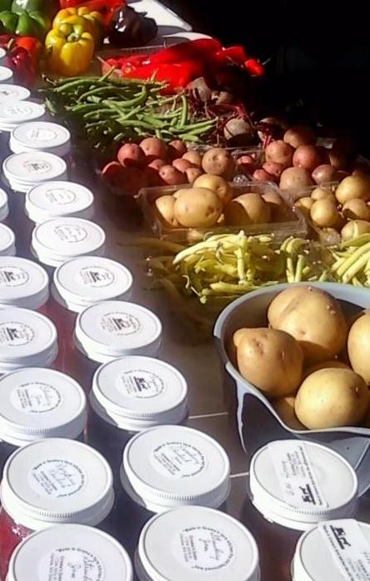
We envision building a healthy community through rural community wellness initiatives.
Notes:
TIME: 1 minute maximum
SPEAKER:
THEME: VISION
As we envision a community with a strong economic infrastructure, we also envision a community that builds a healthy local system of small businesses and amenities that both encourage a NEXT GENERATION of residents that are healthy, and a community that is known, and draws visitors, who highly value local health and wellness services and opportunities.

Slide 21
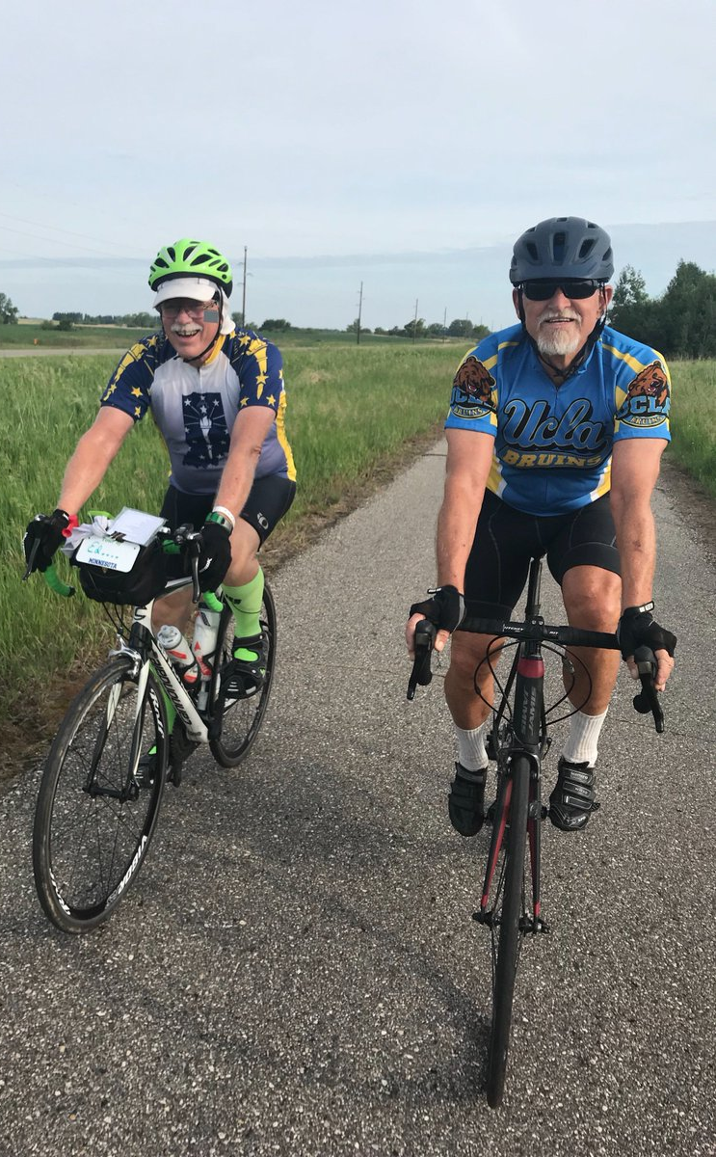
We act to encourage health and wellness
The community urges that we
Further strengthen Little Falls as a healthy community through community wellness and vitality initiatives.
Further support to development of local foods, local agriculture, and the farmers’ markets.
Place increased value on the medical care system & services available locally.
Recognize the importance of bikes and trails, and healthy outdoor as well as winter recreational amenities.
Notes:
TIME: 1 minute maximum
SPEAKER:
THEME: POTENTIAL ACTIONS
What were some of the things highlighted throughout the listening process that we could build off of as we seek to encourage health and wellness? The community was very focused on the “prevention” or wellness. What you see here is a short list of some of the items that were named most frequently by our community:
Educate. Further support those initiatives that are reaching residents of all ages and demographic profiles with the importance of healthy lifestyles, healthy foods, and the connections between local foods, healthy food choices, and healthy lives.
Strengthen the core assets we already have: our local food system, local agriculture, farmers’ market, our trail systems and recreation opportunities. The importance of bikes and trails.
Strengthen access LOCALLY. The community sent the message that they don’t want to have to travel 30 miles or 100 miles outside of the community to access.

Slide 22
THANK YOU!
Thank you to the residents of 56345. The thoughtful, passionate desire to be a part of making a difference in our community has been overwhelming.
Thank you to the OurTown 56345 Steering Committee. It’s leadership, considering all aspects of this process, and as well engagement in the community interview and focus group process is gratefully acknowledged.
Thank you to our generous funders for their support in making this process possible.
Notes:
TIME: 30 second maximum
SPEAKER:

Slide 23
QUESTIONS? Thank you. We appreciate the time to share this important community work.
Notes:
TIME: 5-6 Minutes Max
SPEAKER:
[If every speaker holds to their timeframes as noted, there will be 5-6 minutes left for this Q&A to create a total 30 minute timeframe within the City Council’s meeting agenda.]

